Slide 1



Web Application in Android
Ajay Babar

Slide 2

Contents
1. Introduction to Web Content
2. WebView widget
  I. What is webview.
  II. Properties(Methods) of Webview.
3. Program Demo – Web Browser Application.

Slide 3
Introduction to Web Content
Web Content
Text
Images
Process data
Web Page
Videos

Slide 4
WebView
What is WebView ?
  WebView is an android widget for displaying
  web pages.
  WebView Class resides in the 'android.webkit'
  package.
developer.android.com/reference/android/webkit/package- summary.html
  Working with WebView, we should add
  internet permission in android application's
  manifest file that allows accessing the internet.
  <uses-permission android:name="android.permission.INTERNET">
</uses-permission>

Slide 5
Properties (methods) of WebView
WebView Class
loadData()
reload()
canGoBack()
canGoForward()
loadUrl()
goBack()
goForward()
clearHistory()

Slide 6
Web Application in Android
Program Demo

Slide 7
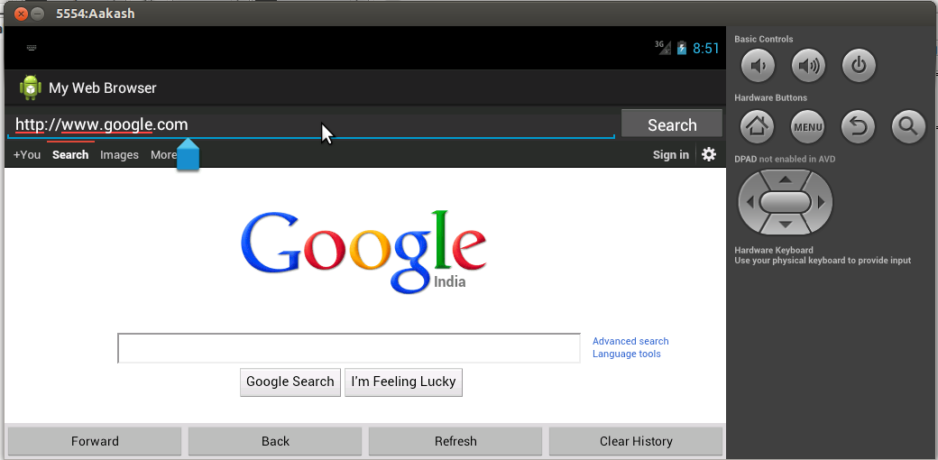
Snapshot of Application
Address Bar
WebView

Slide 8
References
http://developer.android.com/index.html
Android 3.0 Application Developement Cookbook
Creating Android Applications: Develop and
Design - Chris Haseman

